Slide 1

A Project Report On
MILK MANAGEMENT SYSTEM
-: Submitted To :-
Shree R.K.patel bca College, Nanikadi
Under The Guidance
Mr. Piyush patel
(Asst.Professor)
Presented By
SUTHAT SANJAY D. - 25
MILK MANAGEMENT SYSTEM

Slide 2
About Organization
Name : jay Yogeswar Dudh Dairy
Owner : Manish Patel
Mo : +91 7926927780 Address : Jay Ganesh , Kadi Near Under Ground
MILK MANAGEMENT SYSTEM

Slide 3

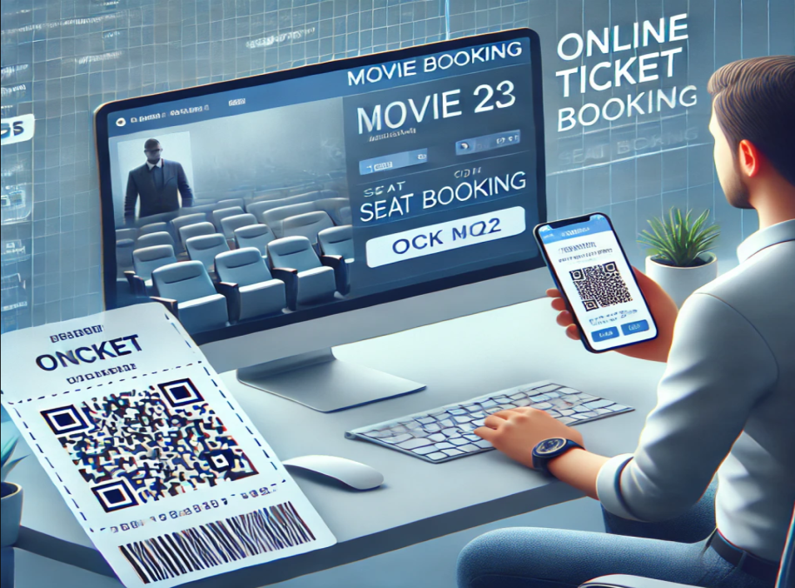
Existing System
Before the Internet:
Finding movie showtimes was difficult.
People relied on newspapers, phone calls, or visiting theaters for showtime details.
Movie tickets were often sold in black, making them expensive and hard to get.
After the Internet:
Users can search for movies easily using a web browser.
People started watching movie trailers on YouTube before deciding to watch a film.
Online platforms like PVR Cinemas made ticket booking convenient.
MILK MANAGEMENT SYSTEM

Slide 4
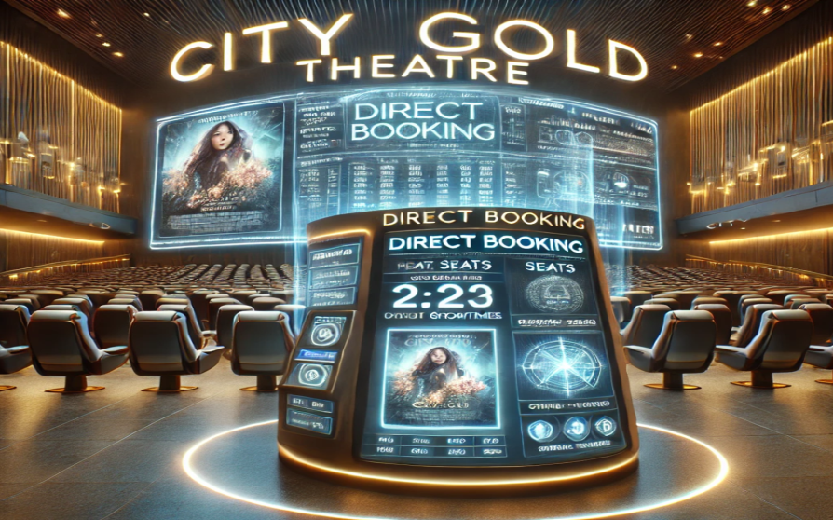
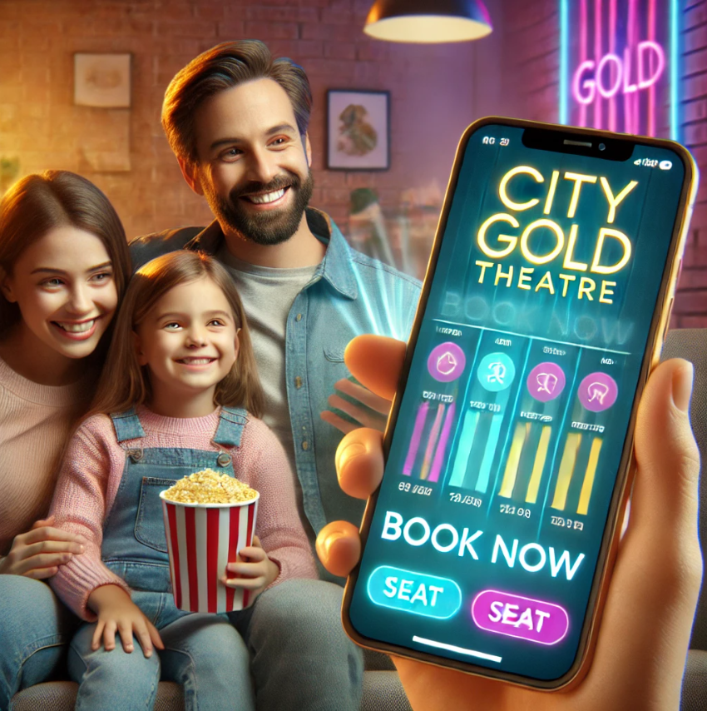
Need For New System
Existing platforms cater to a general audience, lacking personalized user experiences.
No dedicated online booking system for City Gold Theatre for seamless direct bookings.
Lack of key features such as:
Family-friendly movie tags for better selection.
Upcoming movie reminders to keep users informed.
Interactive booking experience for enhanced user engagement.
A modern, user-centric solution is needed to address these gaps and introduce new, innovative features.
MILK MANAGEMENT SYSTEM

Slide 5
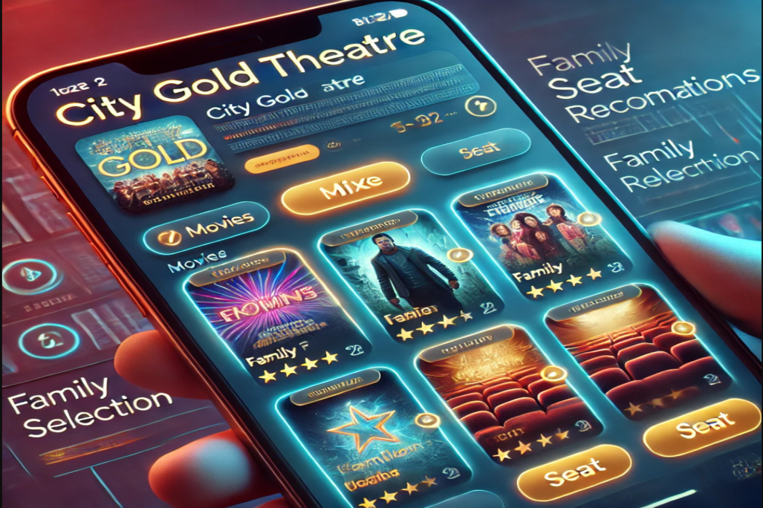
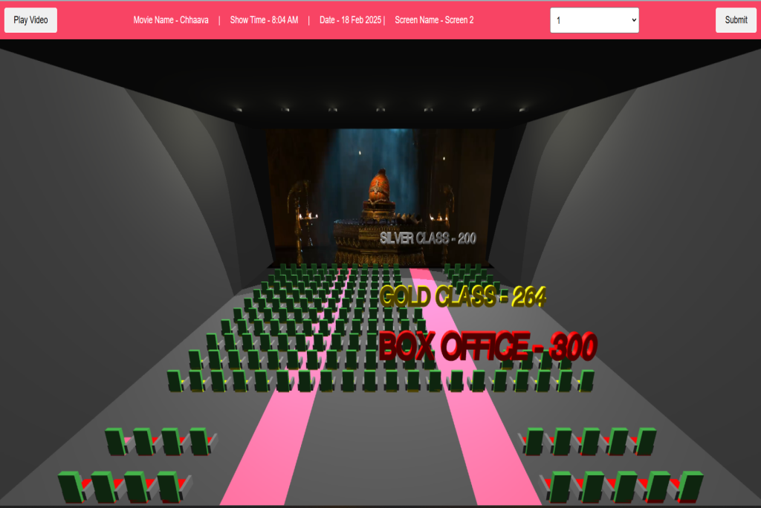
Objective of the System
User-Friendly Interface
Simple and intuitive design for easy navigation.
Quick and hassle-free login, registration, and booking process.
Real-Time Movie Updates
Display the latest and upcoming movies dynamically.
Advanced filters like "Family-Friendly," "Kids Special," and "Trending Now."
Interactive Seat Selection: Color-coded seating (Green = Available, Red - Occupied) for intuitive booking, allowing users to select up to 07 seats at once smoothly.
Smart Notifications & Reminders: Alerts for upcoming family-friendly movies and showtimes.
Payment System : Supports including QR code scanning for quick and hassle-free transactions.
MILK MANAGEMENT SYSTEM

Slide 6
Data Dictionary
SR.NO | TABLE NAME | DESCRIPTION
1 | tbl_admin | Stores administrator account details.
2 | users | stores registered user information, including login credentials and profile details.
3 | tbl_screen | stores information about movie broadcast screens, such as Screen-1, Screen-2, 3
4 | tbl_class | categorizes movie viewing options into Box-Office, Gold, and Silver classes.
5 | tbl_seat | contains details about Total seat Each Screen
6 | tbl_movie_type | defines movie categories such as Action, Family, Comedy, etc.
7 | tbl_movie | stores details about each movie, including title,cast and more detail .
8 | tbl_show_time | records the scheduled times for movie screenings.
9 | tbl_show | stores details of movie screenings, including the movie, time, and Which broadcast screen information.
MILK MANAGEMENT SYSTEM

Slide 7
Data Dictionary
Table Name :- tbl_admin
Field Name | Data Type | Size | Constraint | Field description
admin_id | int | - | Primary Key | uniquely identifies the admin in the system.
admin_email | varchar | 40 | Not Null | stores the email address of the admin user for communication.
admin_password | varchar | 255 | Not Null | stores the encrypted password for secure admin authentication.
MILK MANAGEMENT SYSTEM

Slide 8
Context Level DFD
Request_book_ticket
Get_booking_detail
Online Movie Ticket Booking System
Ticket_booker
Admin
0.0
Get_ticket_id
conform
Online Movie Ticket Booking System

Slide 9
First Level DFD for Admin side
Give admin detail
Authentication
Login
admin
tbl_admin
Go admin page
Auth success/not
1.0
Add screen detail
Store detail
Manage
screen
tbl_screen
View detail
1.1
Store success
Add class detail
Store class
Manage
class
tbl_class
View class detail
Store success
1.2
Store seat
Add seat detail
Manage
seat
tbl_seat
View seat detail
Store success
1.3
Online Movie Ticket Booking System

Slide 10
Hierarchical chart
Online Movie Ticket Booking System
Admin
User
Login
View Availableshow
View
Movie
Manage_screen
Manage class
Manage seat
Manage movie
Manage show
Manage booking ticket
Login/Registration
Cancel_Booking
Book ticket
Online Movie Ticket Booking System

Slide 11
THANK YOU
Online Movie Ticket Booking System

